Slide 1
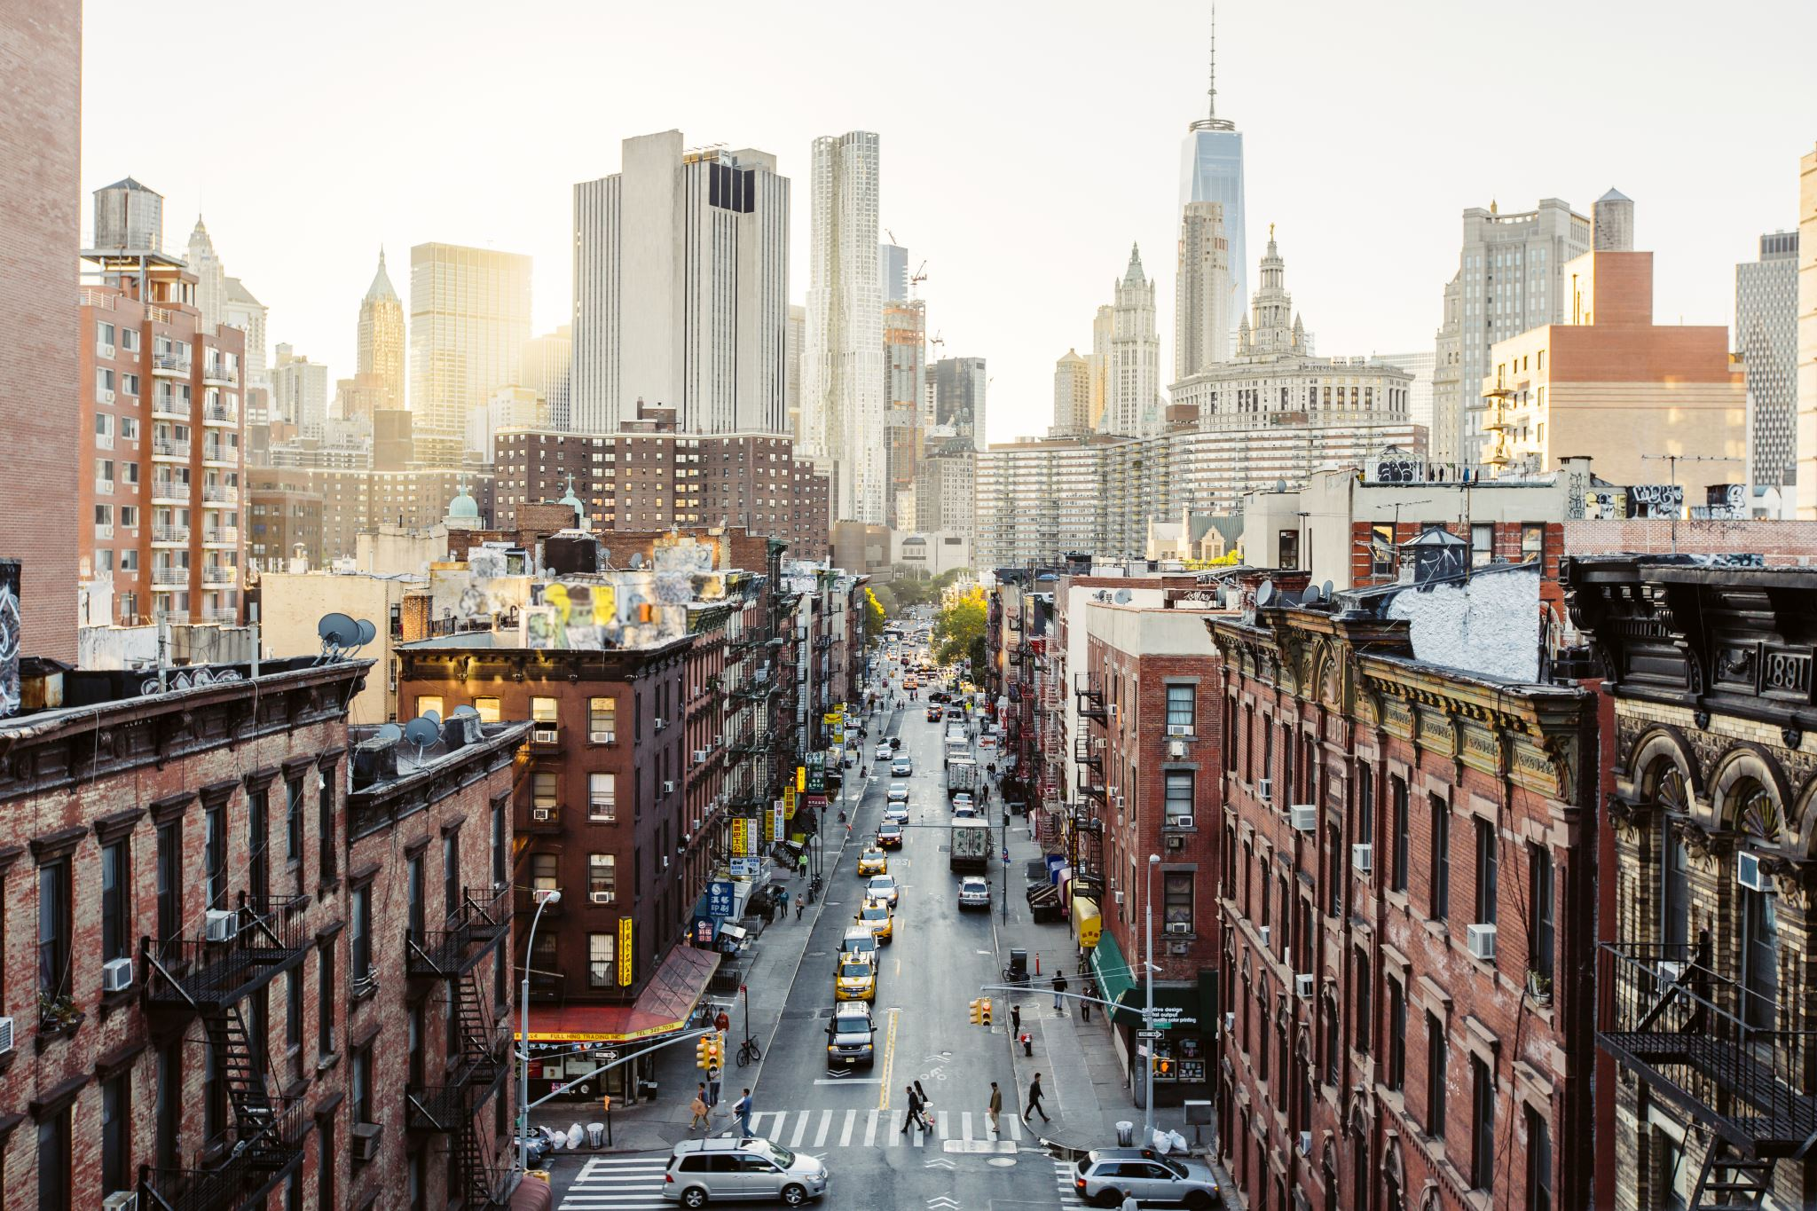
WEB SCRAPPING PROJECT - Toronto rental prices
Analysis of the rental market of the city of Toronto - Canada
Notes:
Line spacing + Page numbers

Slide 2
Content
01 Motivation and data gathering
02 The dataset
03 Findings
04 Challenges
05 Conclusion and next steps

Slide 3
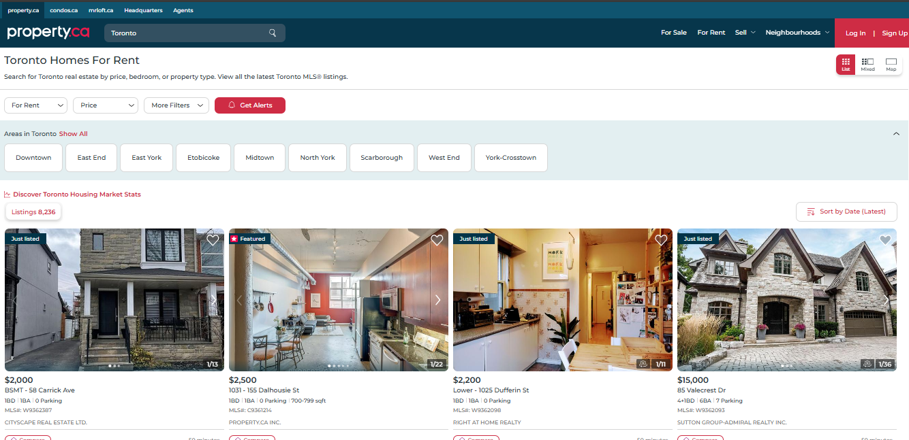
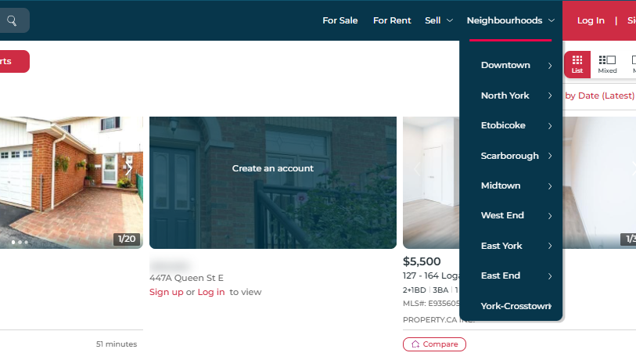
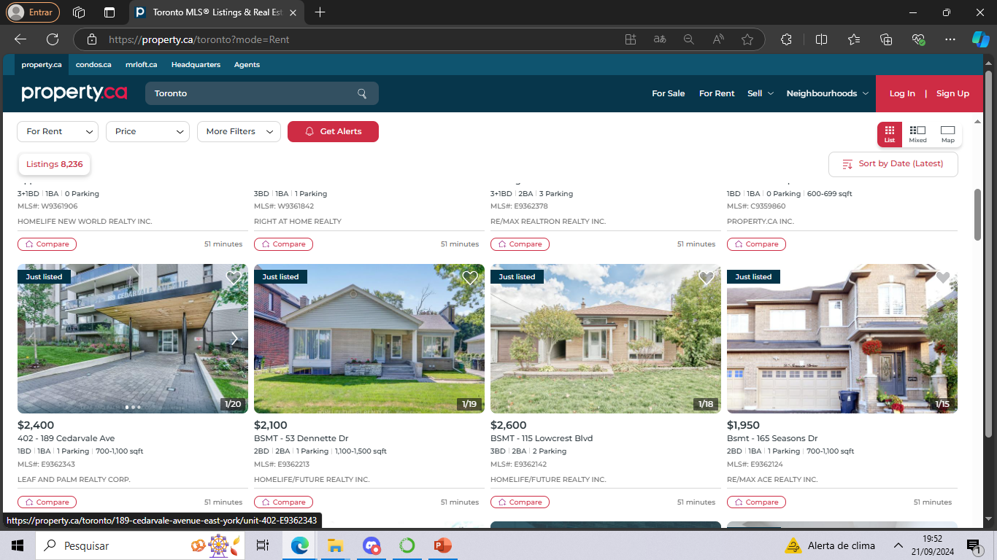
Motivation and data gathering
01
Website property.ca/toronto?mode=Rent
Rental data by region and neigbourhood

Slide 4
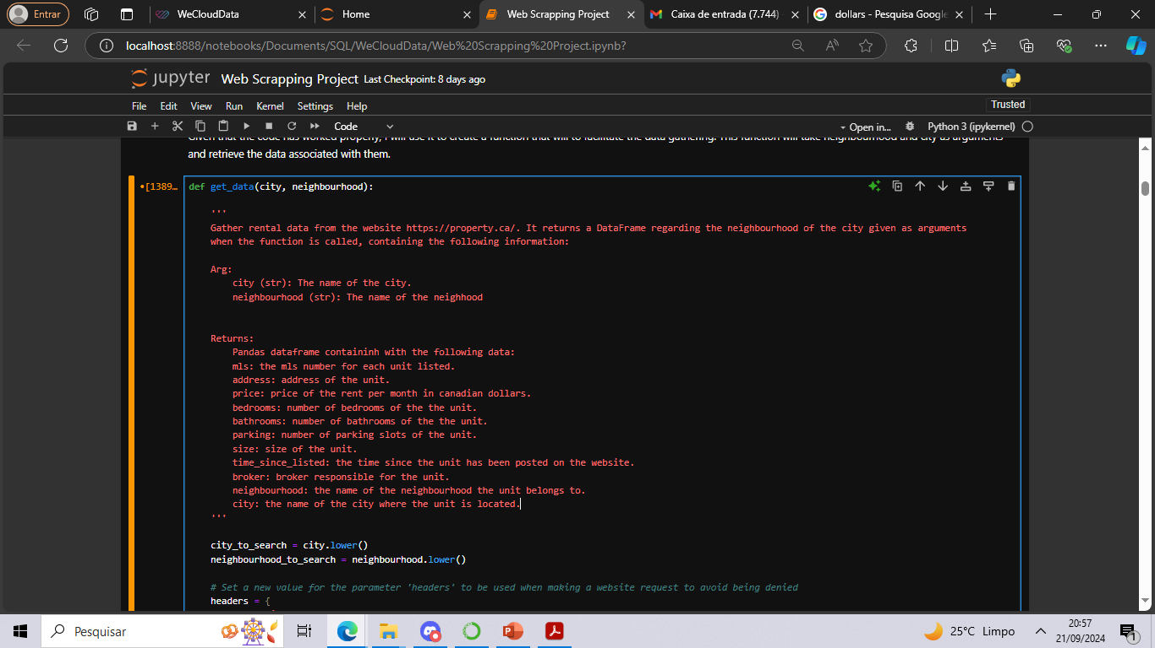
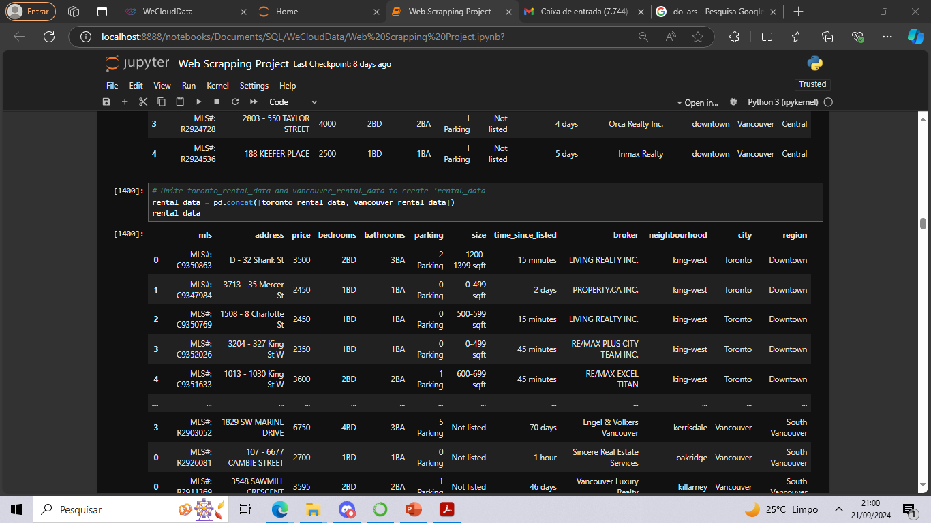
Motivation and data gathering
01
Web requests using request
Html parsing using BeautifulSoup
Dataframe creation using pandas

Slide 5
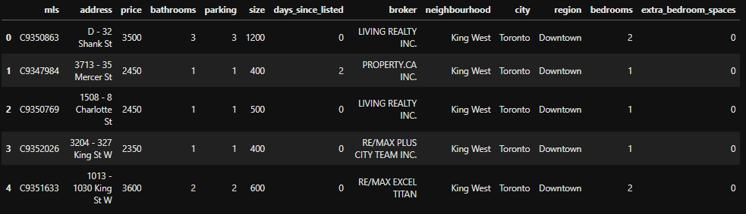
The dataset
02
Duplicates were removed
01
The format of the data (such as ‘1BA’) was corrected
02
The data types of variables was changed
03
Abnormal values (i. e. outliers) were examined and dealt with
04
Only observations for the city of Toronto were kept
05

Slide 6
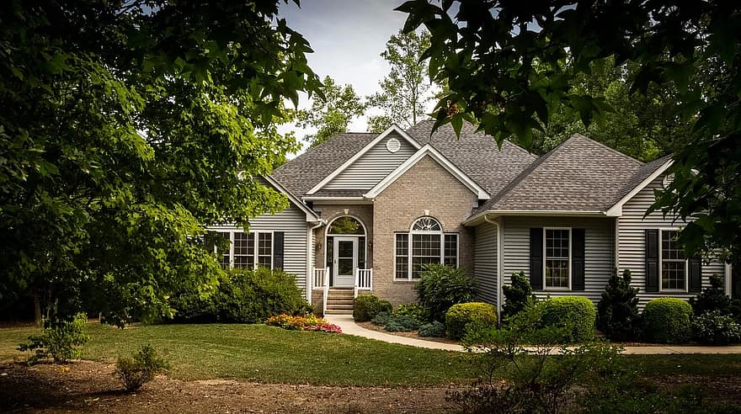
Findings
03
Relationship between price and size
Price per number of bedrooms
Availability of units within each region
Price per sqft for each region
Most expensive and cheapest neighbourhoods

Slide 7
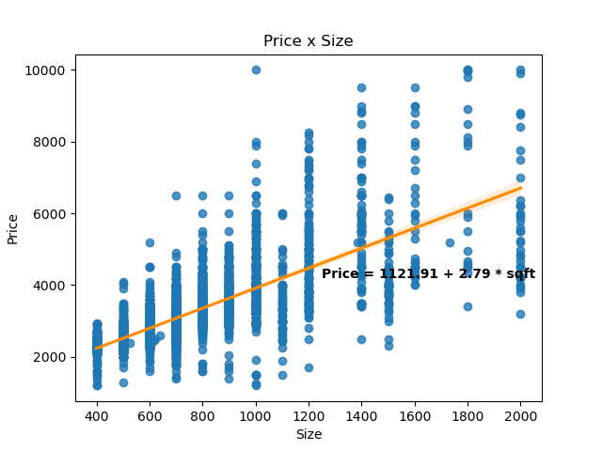
Relationship between price and size
Adjusted R²
0,581

Slide 8
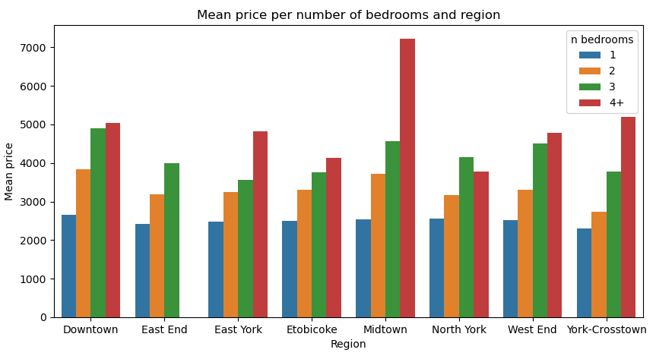
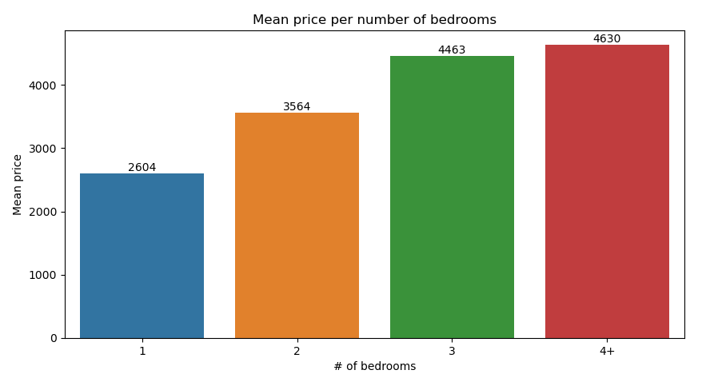
Price per number of bedrooms

Slide 9
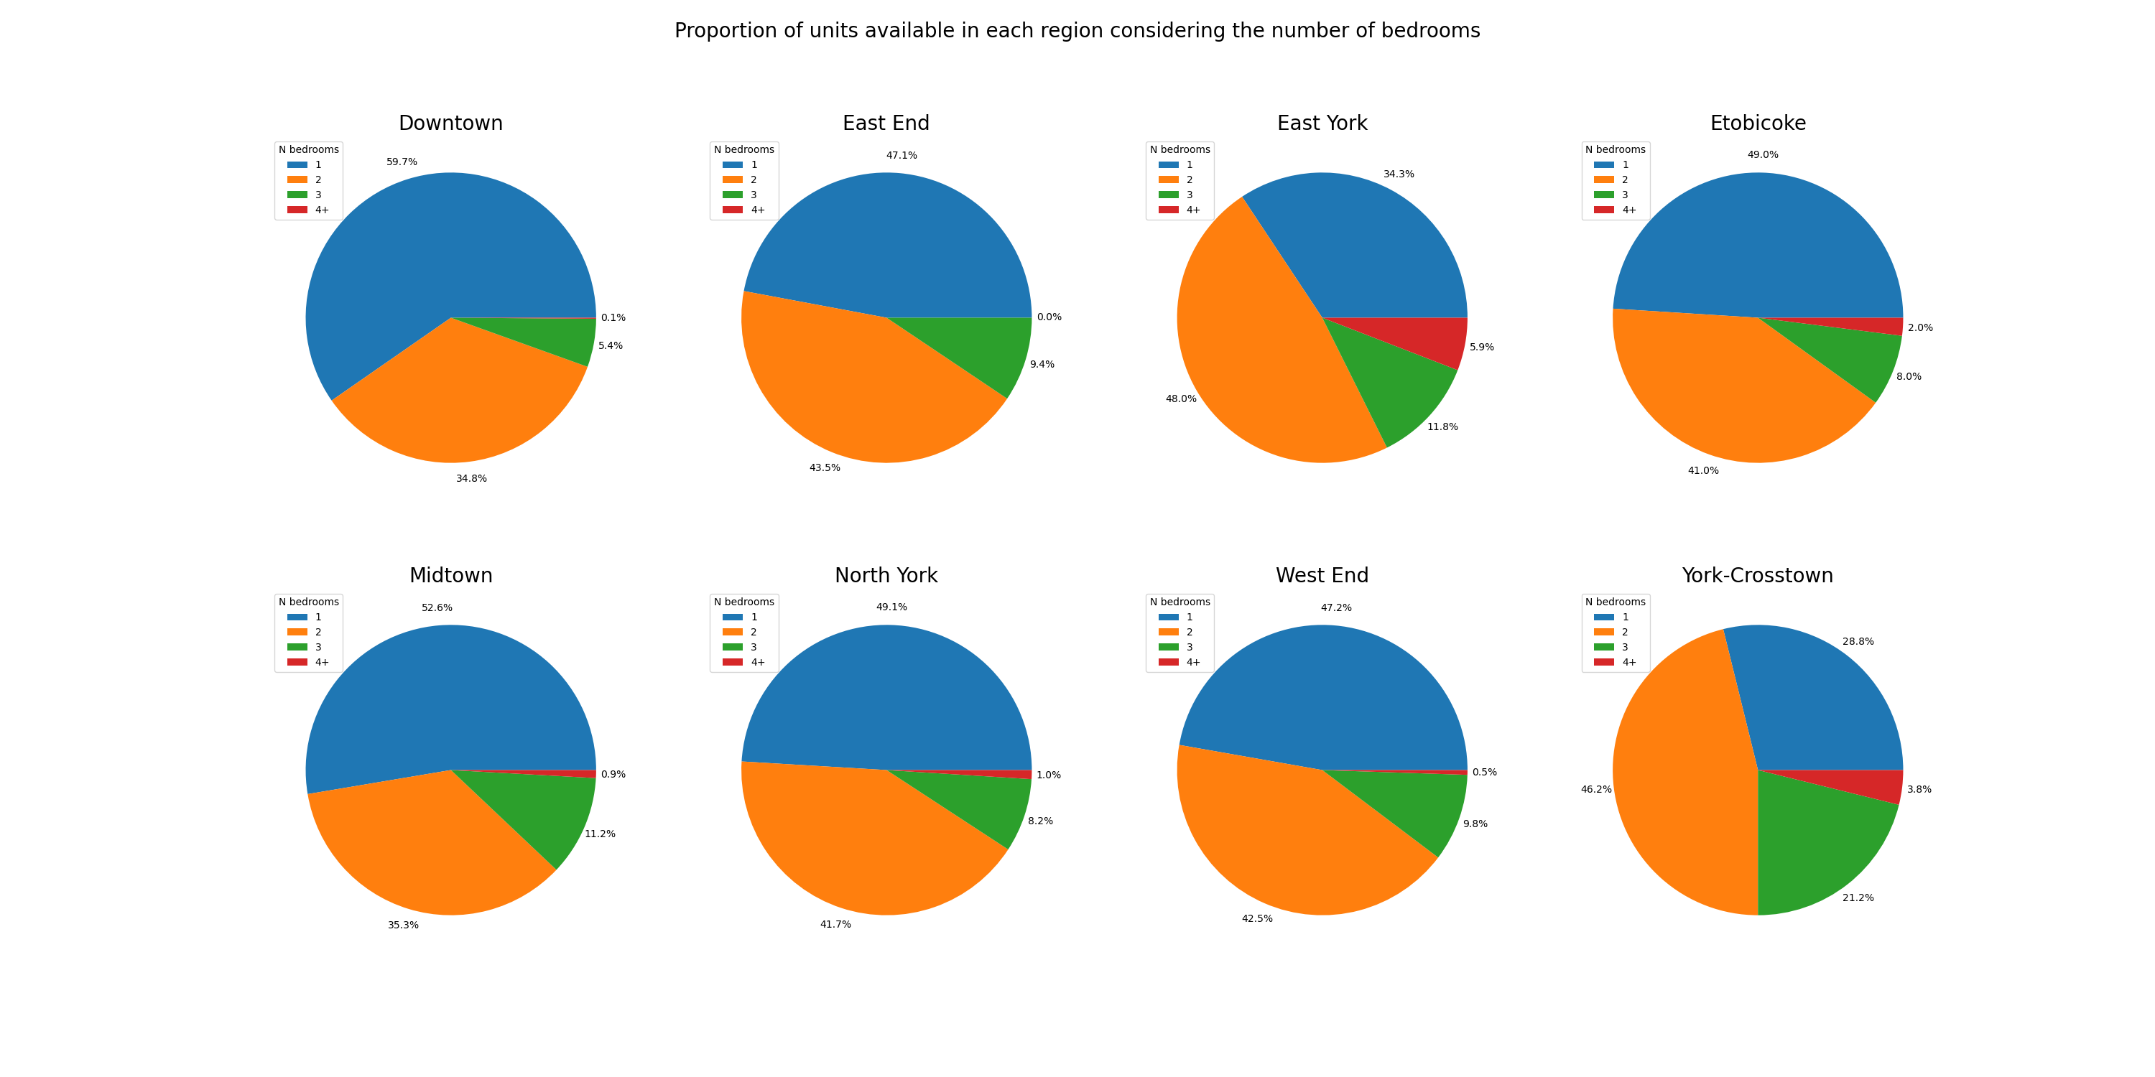
Availability of units within each region

Slide 10
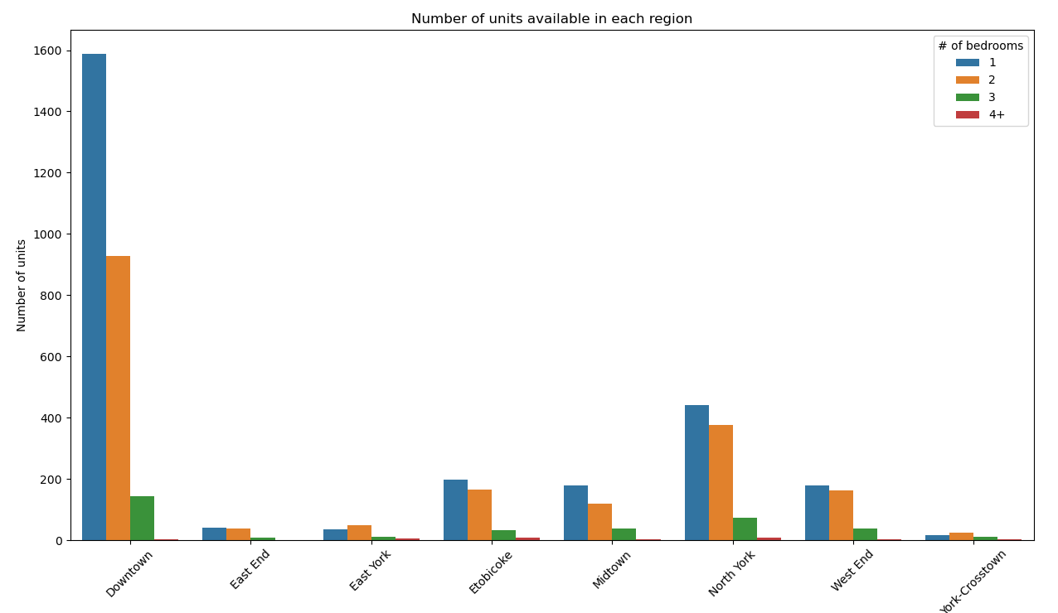
Availability of units within each region

Slide 11
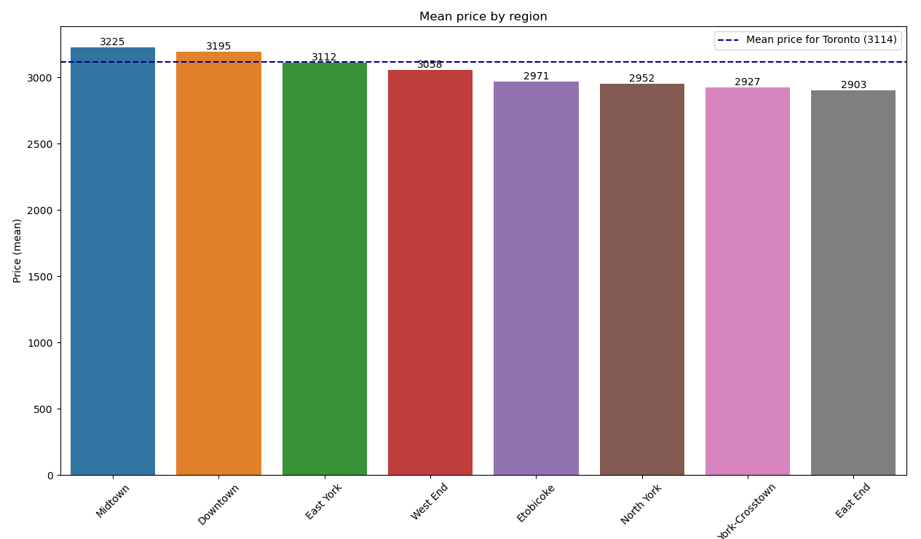
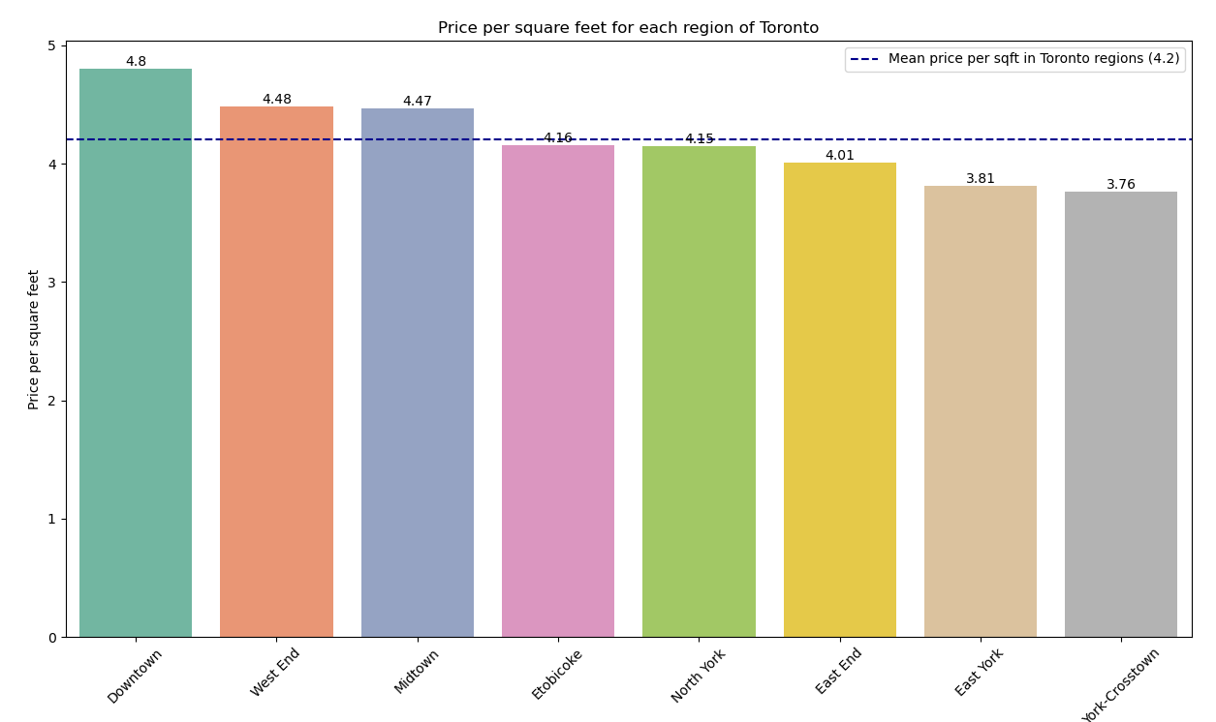
Price per region

Slide 12
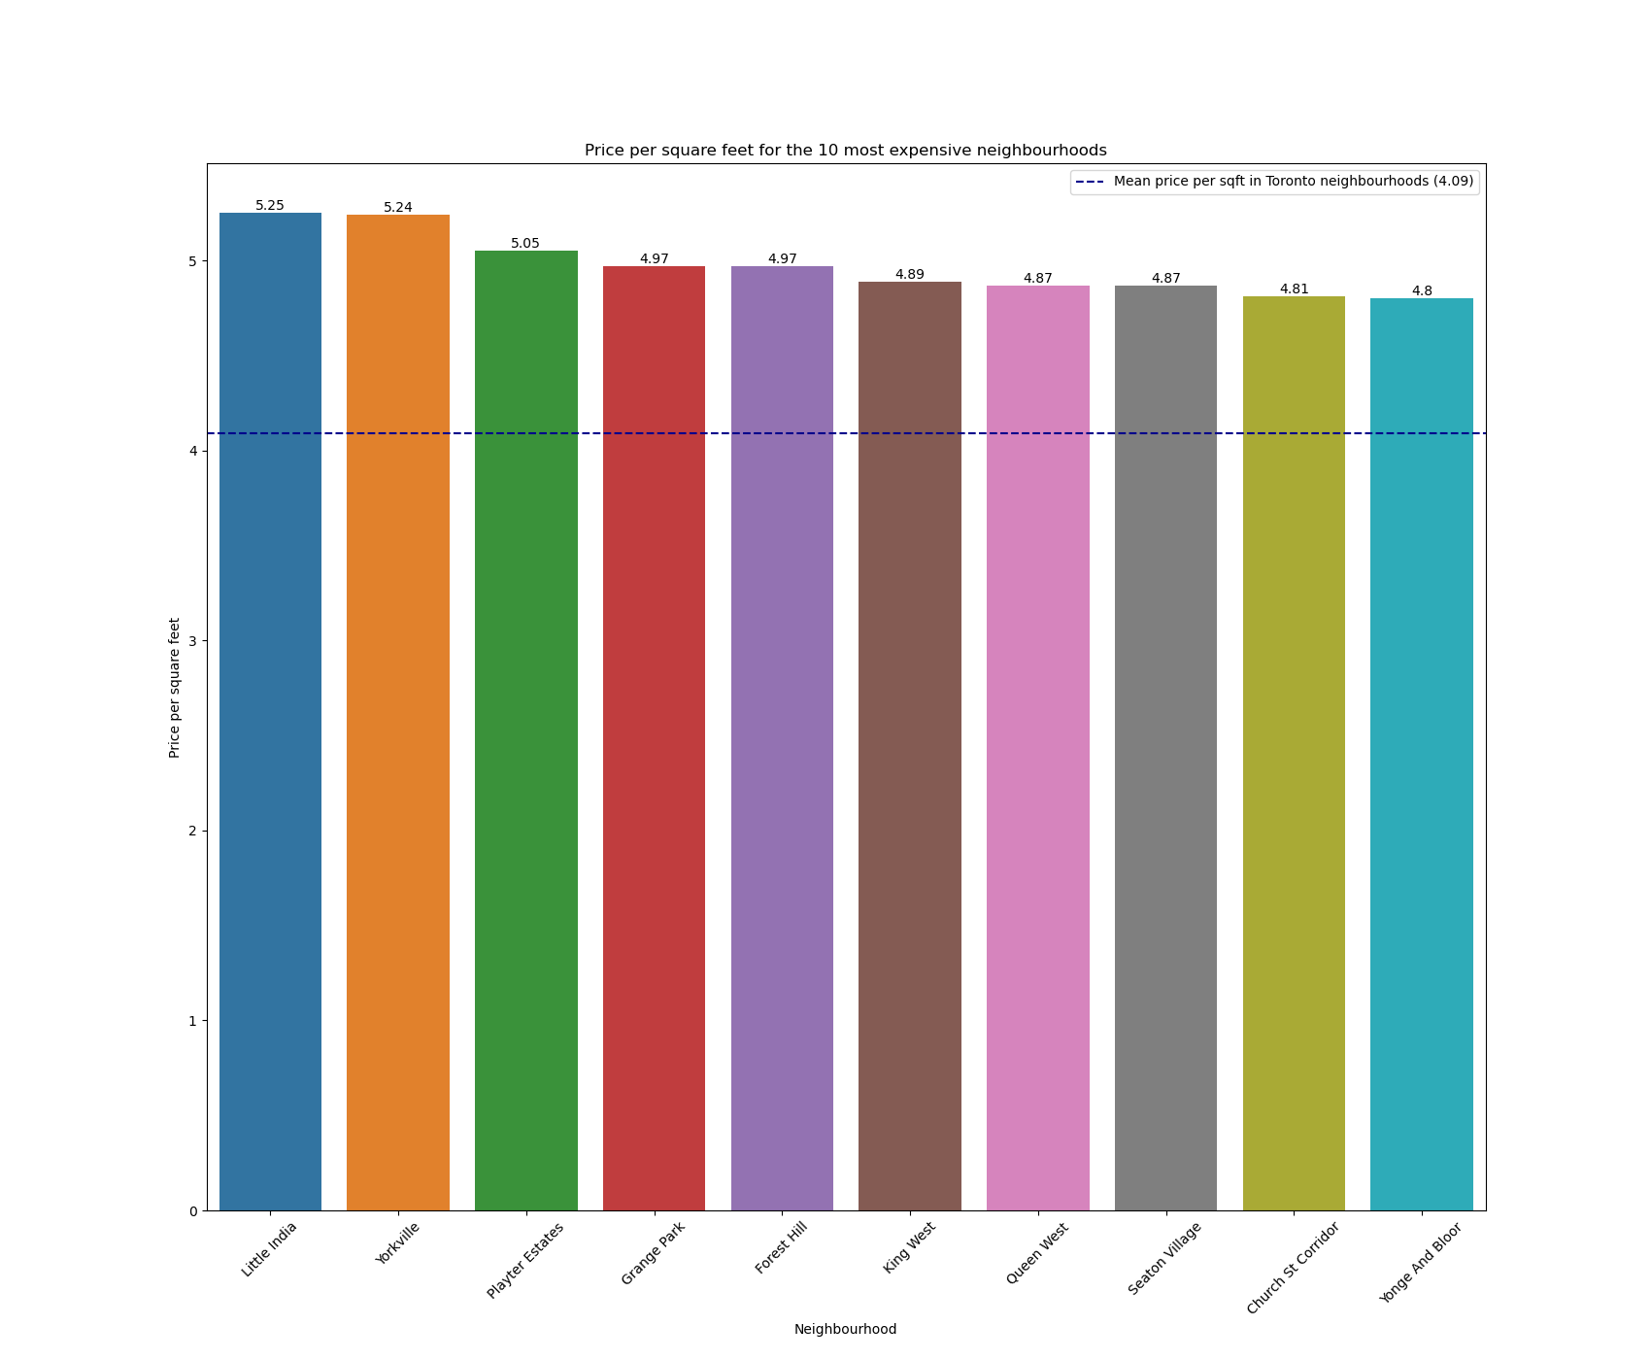
Most expensive neighbourhoods

Slide 13
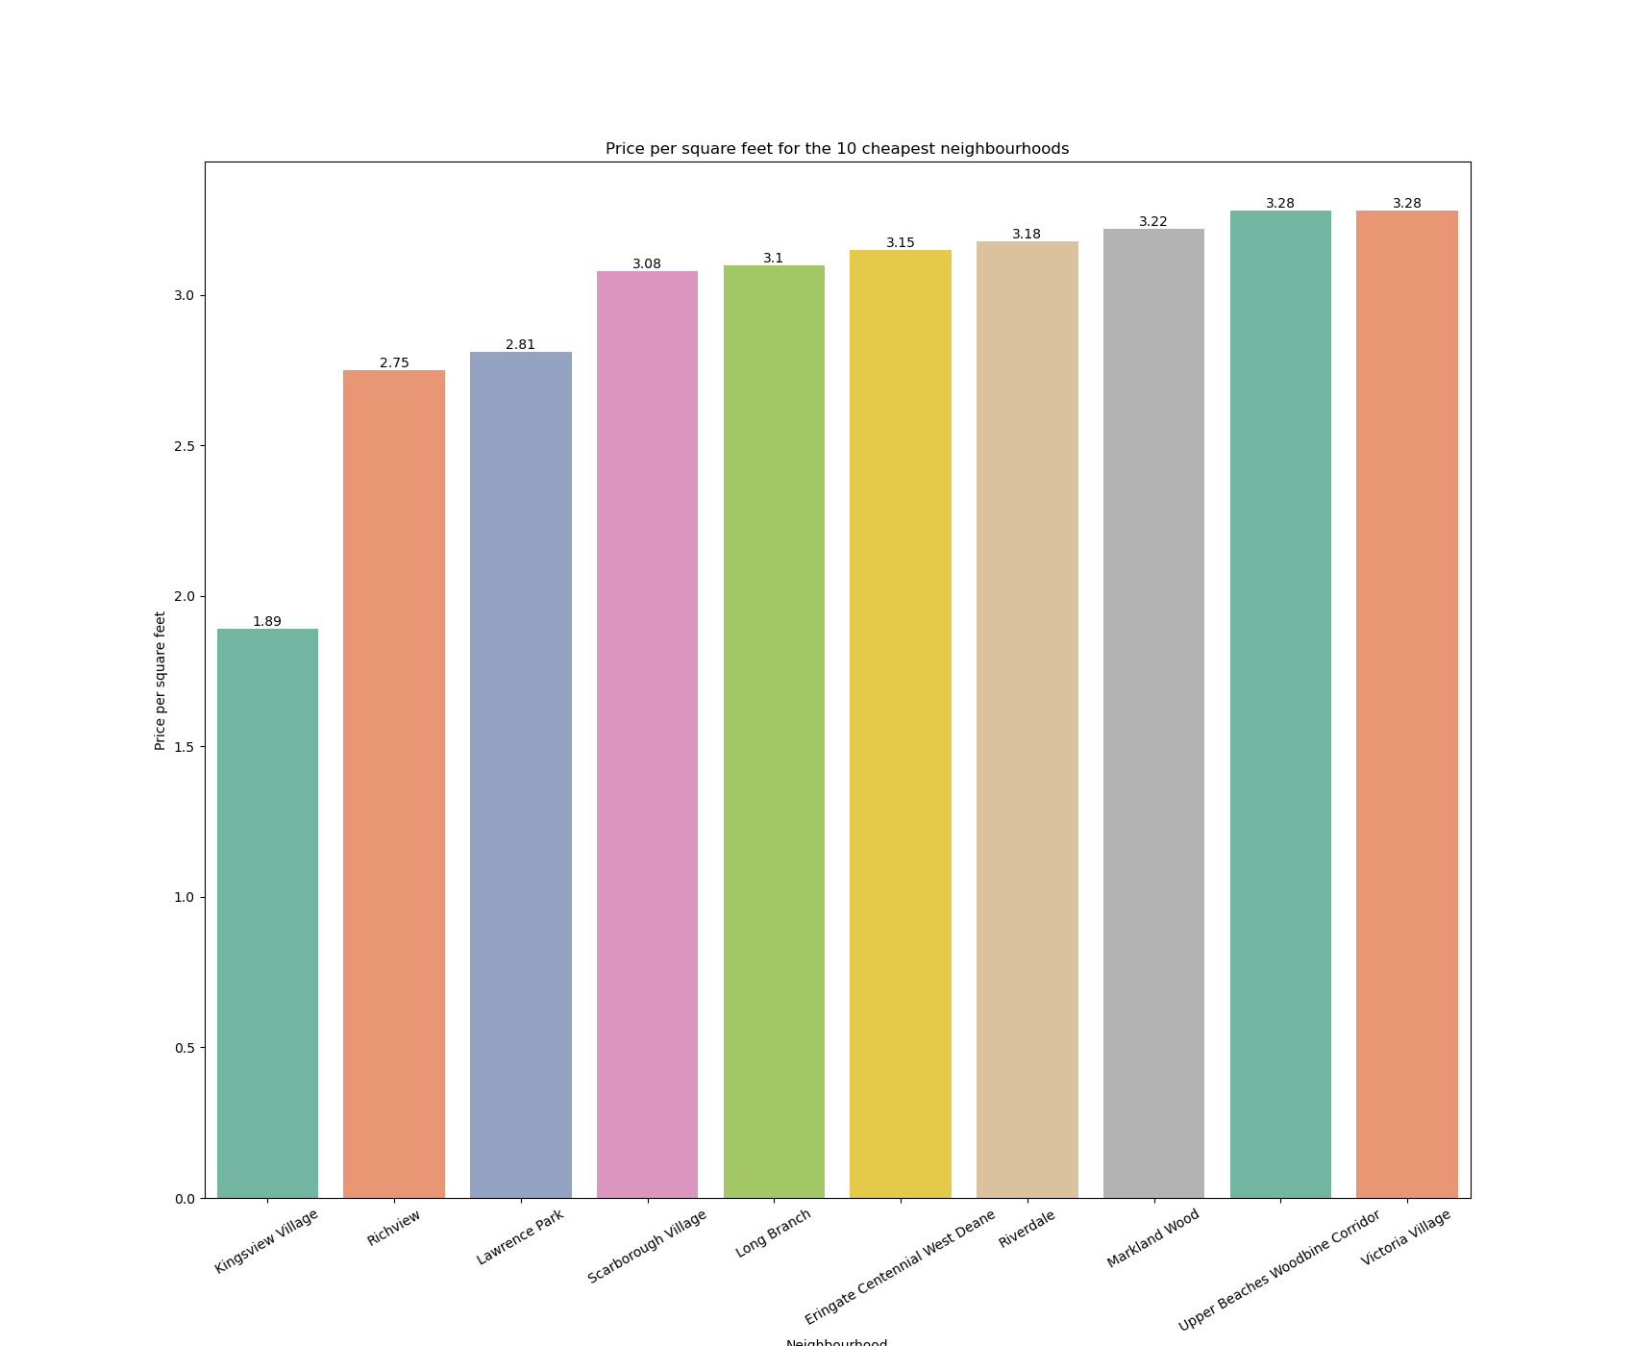
Cheapest neighbourhoods

Slide 14

04
Challenges
Dealing with html request denials
Taking decision about how to deal with abnormal numbers in the data
Narrowing down the analysis to a point of interest

Slide 15
Conclusion and next steps
05
Size and location seems to play an important role when it comes to renting price..
The metric mean price per square feet highlighted here could be used as reference for evaluating renting prices within a given region or neighbourhood and help renters to make better deals.
The next steps for a project such as this could involve the deployment of an interactive html app for users to explore their personal interests and the exploration of the relationship of other variables in the dataset (for example, number of bathrooms and parking slots).

